Slide 1

Active Commuting
Car-free Commuting in a Car-centric City

Slide 2

Cycling (2011-present)
SGA forms Bicycle Infrastructure Improvement Committee
Georgia Tech awarded Gold level BFU
Relay Bike Share is launched
Atlanta ranked #42 on Bicycling’s “50 Best Bike Cities”
2011
2016
2018
2012
2017
Georgia Tech recognized as Silver level Bicycle Friendly University (BFU)
PATH Parkway earns top new bikeway in US from People for Bikes

Slide 3
Scooters (May 2018-present)
City Council Passes ordinance
Georgia Tech launches safety campaign
Bird scooters appear
Atlanta is Bird’s 2nd largest market
Jump e-bikes launch
May
Nov
Jan
Mar
June
Dec
Feb
Lime enters market
Lyft & Uber introduce scooters
Resolution introduced to obtain scooter injury data
Lime issues safety warning regarding brakes

Slide 4
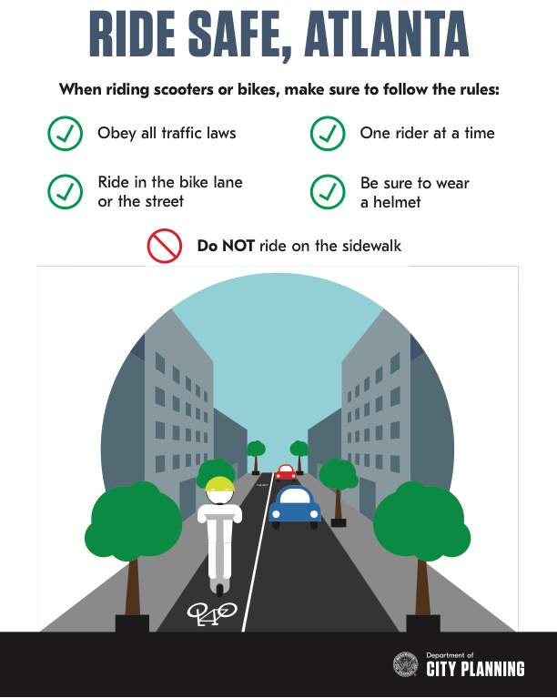
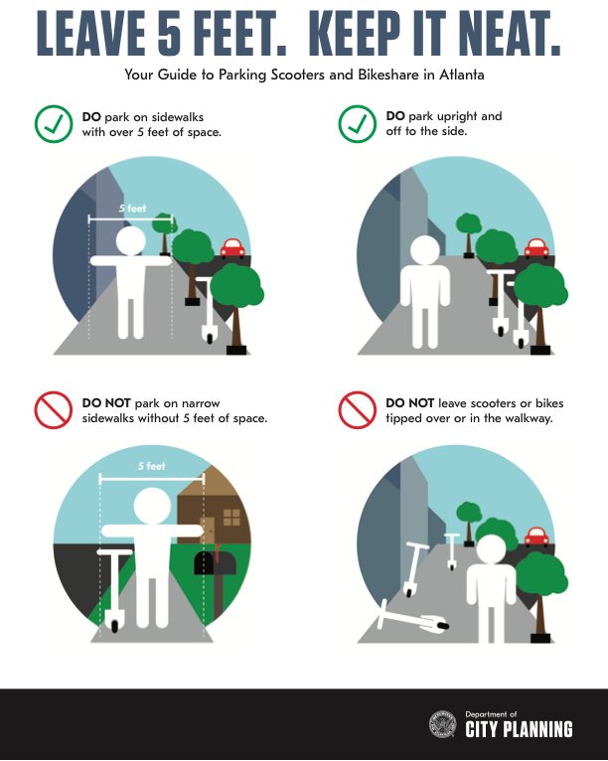
Shareable Dockless Mobility Device Ordinance
Images courtesy of City of Atlanta
Notes:
PEDS Atlanta “Clear the Clutter” campaign
GT park near a bike rack, look for signs

Slide 5
Examining the Ordinance: wear a Helmet
Why wear helmet?
Helmets reduce the risk of severe traumatic brain injury by 51% and facial fractures by 31% (Olivier, 2016)
Helmet options
PTS sells helmets for $12
Ride Smart attendees receive free helmets
scrape, sprain
fracture
Crash resulting in head injury
2019 Injuries from E-Scooter Crashes (UCLA Hospital emergency room data) (Trivedi, 2019)
Notes:
GA law: under 16 must wear helmet

Slide 6
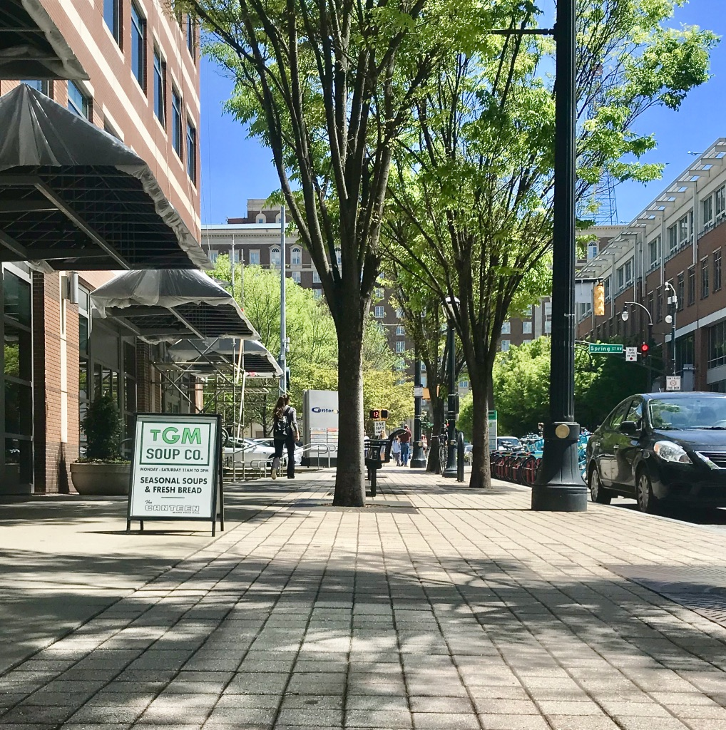
Examining the Ordinance: Ride in the Bike Lane
Hit by vehicle
Collision with object
Objects
Intersection
Injuries resulting from falling from scooter
Uneven surface
Notes:
3% of bicycle crashes occur in bike lane (US DOT from 2015)
over age 12

Slide 7
Benefits of active commuting

Slide 8
Active Transportation: Financial Benefit
In 2018, Atlanta ranked as the 8th most congested city in the world,
and the 8th most expensive city in which to own a car, with an average annual cost of $11,578 (INRIX, 2018).
The average annual cost to own and maintain a bike is $308 (Sierra Club, 2012).
Notes:
Not just direct costs; active lifestyle lower healthcare costs of 400-500/year

Slide 9
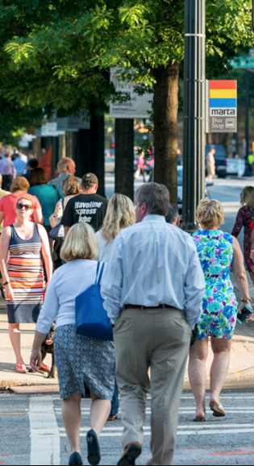
Active Transportation: Environmental Impact
During the seventeen days of the 1996 Olympics, an alternative transportation strategy was implemented that reduced traffic density in downtown.
Peak daily ozone concentrations decreased by 27.9%.
Acute pediatric asthma events decreased by 41.6% (Friedman, 2001).
Notes:
Asthma from tailpipe
how much driving in city predicts asthma rate
Asthma rates 3x in 1990’s

Slide 10

Workday of Full-time Employee in U.S.
13 minutes activity
62 minutes average roundtrip Atlanta commute (U.S. Census Bureau, 2016)
U.S. Bureau of Labor Statistics,
Notes:
replacing a car ride with physical activity added 3-14 months to bike commuter life.
CDC: adults gain most 150-300 min/week moderate intensity (2.5mph or faster). Across a five day work week= 30-60 minutes per day
biking to work 46% lower risk of developing cardiovascular disease; walking 27%
It’s not just that bike commuting reduces the stress of commuting, but the act of cycling itself reduces days of poor mental health by 21.6%.

Slide 11
Options with active commuting

Slide 12
Mixed-Mode Commuting
Bus Service
Bus services link 12 metro counties to Civic Center and North Ave stations from approximately 5:30-9am and 3:30-7pm.
Civic Center Station is a 22 minute walk or 10 minute bike ride from campus. All buses have bike racks.
MARTA
MARTA welcomes bikes on trains and has racks on the front of all buses.
Notes:
The SmartPark permit costs $25 each year and allows daily parking in four lots for $6 per use.
Walking 21 minutes can cut your risk of heart disease by 30%;

Slide 13
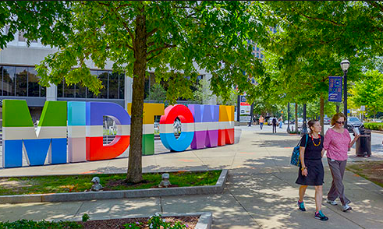
Common Concerns: Needing a Car
Car Options
Georgia Commute Options: Guaranteed Ride Home provides five free rides per year to alternative commuters due to unexpected events
Driving to campus
The SmartPark permit costs $25 each year and allows daily parking in four lots for $6 per use.

Slide 14
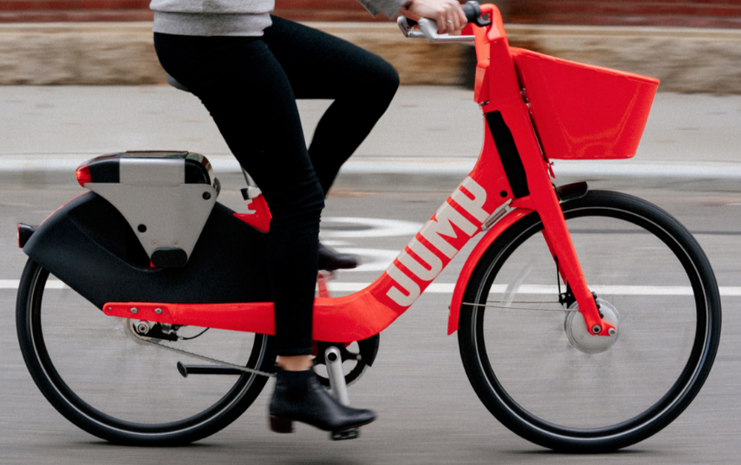
E-bikes
Georgia Law
Motor must be under 1,000w, max speed of 20mph, and operable pedals
Replacing Cars
2018 study of found owners replace 46% of car commutes and 30% of driving errands with e-bikes

Slide 15
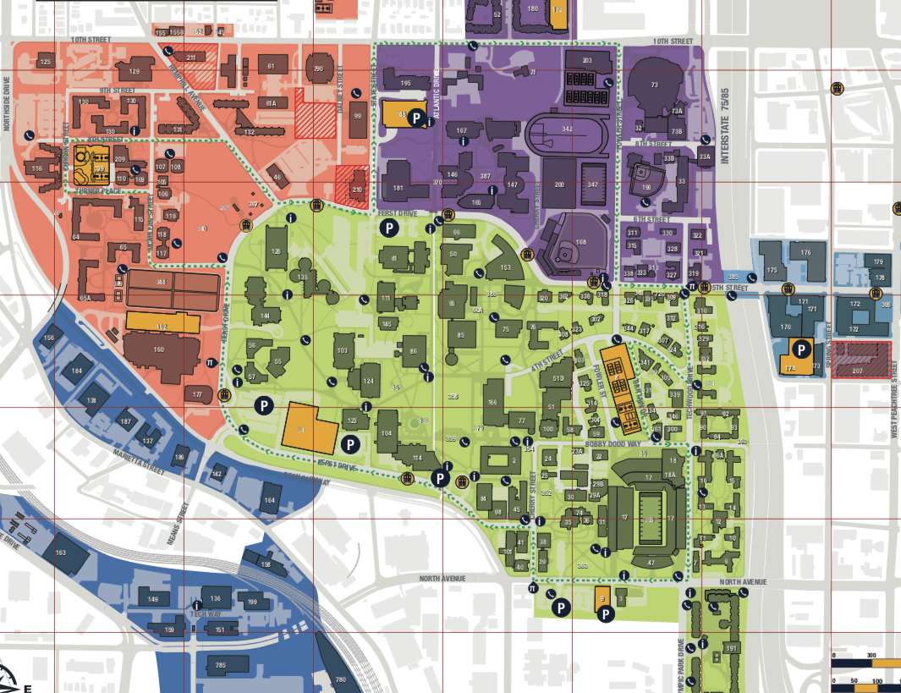
Active Commuting on Campus
West Peachtree at Fifth to CRC (via fastest route)
9 minutes
8 minutes
20 minutes
Notes:
Bikes are faster than cars for trips under 5k in urban environments

Slide 16
Starting an Active commute

Slide 17
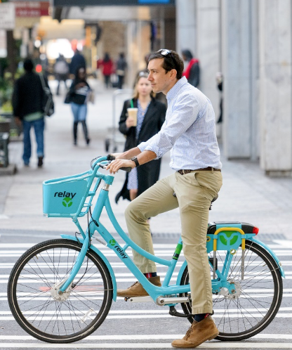
Starting an Active Commute
Learn More
Find Your Path
Be realistic
Try It First
Create a Budget
Know Repair Resources
Have an Back-up Plan
Notes:
Georgia Commute Options: Guaranteed Ride Home provides five free rides per year to alternative commuters due to unexpected

Slide 18
Bike Georgia Tech bike.gatech.edu bike.gt@gatech.edu
Parking and Transportation pts.gatech.edu commute.gatech.edu
Georgia Commute Options gacommuteoptions.com
PEDS Atlanta peds.org
Atlanta Bicycle Coalition atlantabike.org

