Slide 1
Staff Council Inform Series
Driving Your Career at Tech
August 28, 2019

Slide 2
Welcome from Staff Council!

Slide 3
TAP/STRAP PROGRAM DIFFERENCES
 | Tuition Assistance Program (TAP) | Staff Tuition Reimbursement Assistance Program (STRAP)
Employment Requirement | 6 months full-time (100%), benefits-eligible by application deadline date | 12 months full-time (100%), benefits-eligible by application deadline date
Eligible Colleges/Institutions | Any USG institution | Any accredited, private college or institution
Credit Limits | Up to 9 credit hours per semester | Up to 6 credit hours per semester
Grade Requirements | “C” or better | “C” or better
Assistance Method | Tuition payment waiver applied up front | Reimbursement received after term up to the GT rate
Eligible Degree | Any degree except medical, dental, law, executive total cost programs | Any degree except medical, dental, law

Slide 4
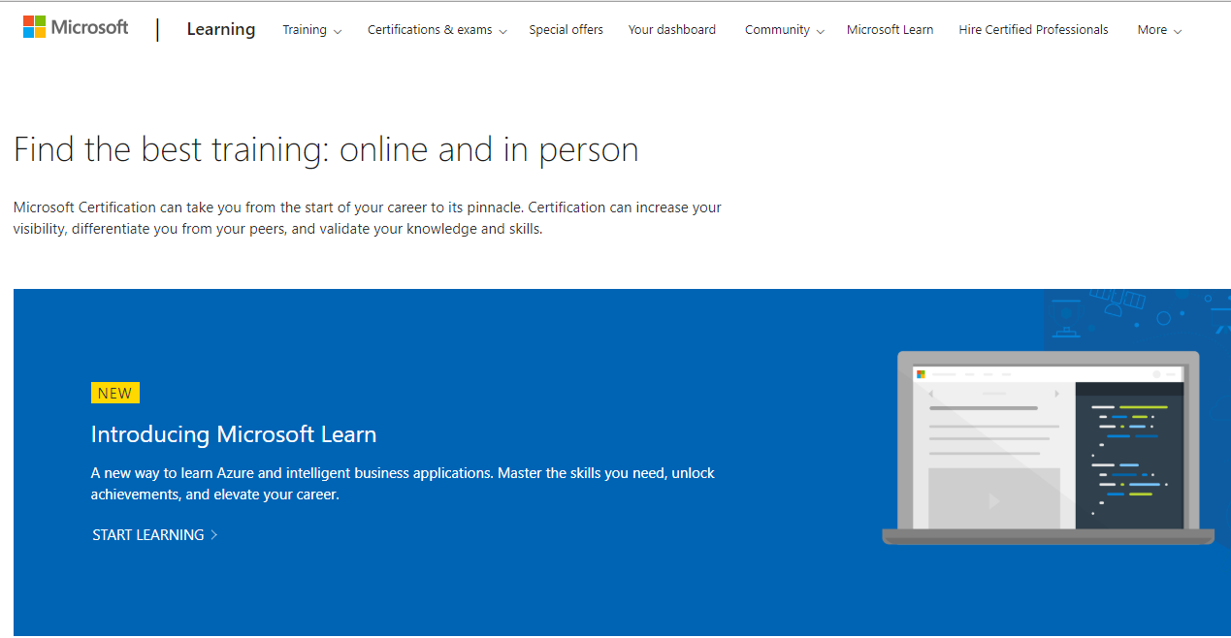
ONLINE LEARNING
https://hr.gatech.edu/learning-development

Slide 5
GTPE
https://pe.gatech.edu/

Slide 6
Workplace Learning & Professional Development
https://hr.gatech.edu/learning-development

Slide 7
Diversity and Inclusion
https://diversity.gatech.edu/

Slide 8
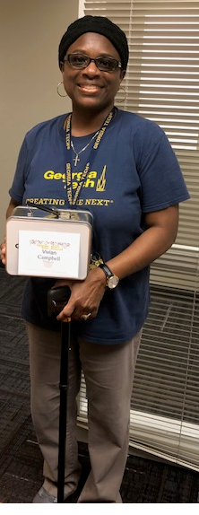
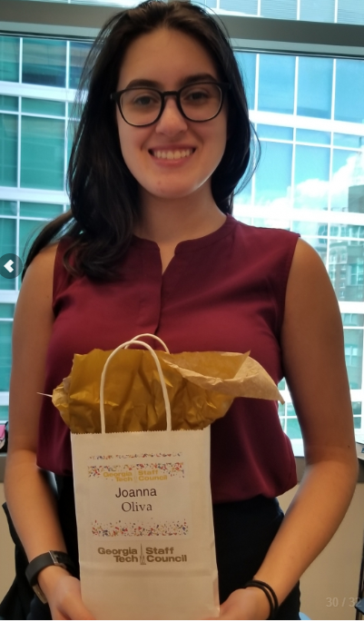
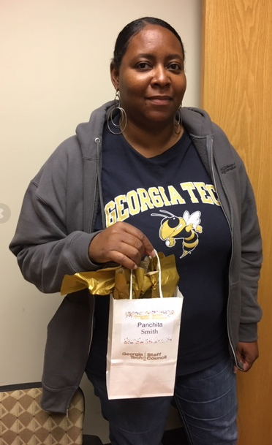
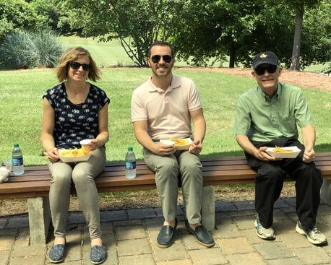
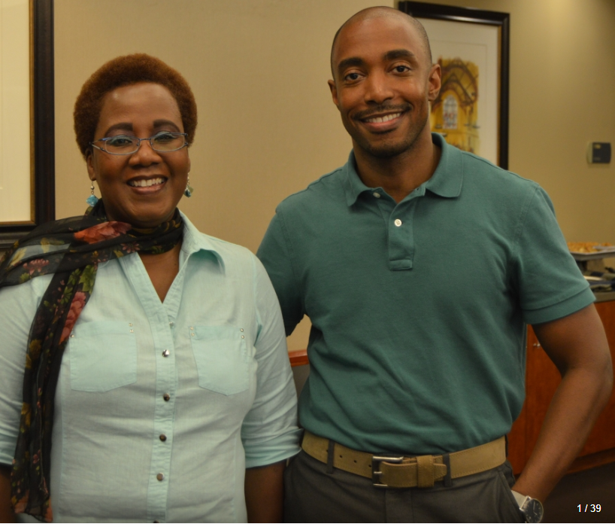
Staff Council
https://staffcouncil.gatech.edu/

Slide 9
Dr. Tia Jackson-Truitt, Associate Director - Educational Outreach Initiatives, CEED

Slide 10
Sterling Dunkley, Talent Consultant, Sr., GTHR

Slide 11
Q&A

